Slide 1

Microservices
Hanith Atluri

Slide 2

What are microservices?
Microservices refer to an architectural style in software development where an application is structured as a collection of loosely coupled, independently deployable services. Each service is focused on a specific business functionality and can be developed, deployed, and scaled independently. These services typically communicate with each other over standard protocols, such as HTTP or messaging queues.

Slide 3

Key characteristics of microservices include:
Independent Services: Each microservice is a self-contained unit responsible for a specific business function, like user authentication or order processing.
Loose Coupling: Microservices are designed to be decoupled, meaning changes to one service should not directly affect others.
Technology Agnostic: Each microservice can be written in different programming languages or use different data storage solutions, as long as they communicate via standard interfaces.
Scalability: Microservices can be scaled independently depending on demand. For example, if one service experiences high traffic, it can be scaled up without affecting other services.
Resilience: Since services are isolated from each other, failure in one service doesn't bring down the entire system. Proper error handling and retries help maintain resilience.
Continuous Delivery: Microservices facilitate faster development cycles, allowing teams to build, test, and deploy smaller features and updates more frequently.

Slide 4
What are the advantages and disadvantages of microservices
Advantages: 1. Scalability 2. Flexibility in Technology and Tools 3. Faster Development and Deployment 4. Resilience and Fault Isolation 5. Improved Maintainability 6. Easier to Scale Teams 7. Better Support for Complex and Large Systems 8. Technology Agnostic
Disadvantages: 1. Complexity in Management 2. Increased Latency 3. Data Management and Consistency 4. Higher Overhead in Communication 5. Deployment Complexity 6. Testing Challenges 7. Increased Infrastructure Cost 8. Skillset and Resource Requirements 9. Challenges in Monitoring and Debugging

Slide 5
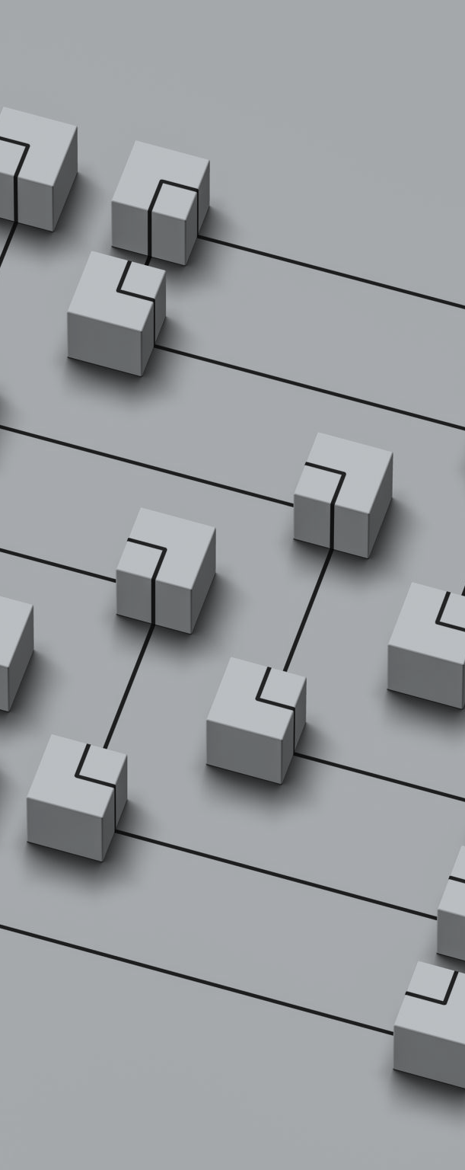
what are the ways to achieve microservice architecture?
Achieving a microservices architecture involves several key steps, methodologies, and tools to break down a monolithic application into independent, self-contained services that interact with each other. 1. Service Decomposition 2. Define Clear APIs and Contracts 3. Decentralized Data Management 4. Decouple Services with Messaging Systems 5. Automation of Development and Deployment (CI/CD) 6. Service Discovery 7. Fault Tolerance and Resilience 8. Centralized Logging and Monitoring 9. Security and Authentication 10. DevOps Culture and Governance
Tools and Technologies to Help Achieve Microservices Architecture Docker: For containerizing microservices.
Kubernetes: For orchestrating and managing containerized services.
Kafka, RabbitMQ: For event-driven communication.
Spring Boot, Node.js: Popular frameworks for developing microservices.
Consul, Eureka: For service discovery.
Prometheus, Grafana: For monitoring and alerting.
Hystrix, Resilience4j: For implementing fault tolerance patterns.

Slide 6

what is monolithic architecture?
Monolithic architecture refers to a software design pattern where the entire application is built as a single, unified, and tightly-coupled unit. In this approach, all the components of the application (such as the user interface, business logic, and data access layers) are bundled together in one large codebase and deployed as a single unit.
Key Characteristics of Monolithic Architecture: 1. Single Codebase 2. Tightly Coupled 3. Single Deployment Unit 4. Shared Database 5. Single Technology Stack

Slide 7

Advantages of Monolithic Architecture:
Simplicity: For small applications, a monolithic approach is relatively simple to design, develop, and deploy. There's only one codebase to manage, which can make it easier to get started.
Performance: Since all the components are in a single codebase, there's minimal overhead for communication between them (no need for inter-service communication via networks). This can result in better performance for certain types of applications.
Easier to Develop and Test (at Small Scale): Monolithic applications can be easier to develop and test initially, as there is less complexity in terms of distributed systems, service communication, and infrastructure management.
Unified Deployment: Since the application is deployed as a single unit, it simplifies the deployment process. There's no need to manage and deploy multiple services or services interacting with each other.

Slide 8

Disadvantages of Monolithic Architecture:
Scalability Issues: As the application grows, it becomes harder to scale individual components. You have to scale the entire monolithic application, even if only one part of the application is under heavy load. This can lead to inefficient resource usage.
Difficult to Maintain and Evolve: Over time, as the application becomes larger, the codebase can become complex and harder to maintain. Small changes may require touching multiple parts of the application, which increases the risk of introducing bugs.
Longer Development Cycles: As the application grows, it can take longer to make and test changes. A small update or bug fix might require a complete rebuild and redeployment of the entire application, which can slow down the release cycle.
Limited Flexibility in Technology Choices: Since all components are tightly integrated, changing the underlying technology stack (for example, switching to a new database or framework) can be difficult, as it may require rewriting large parts of the application.
Single Point of Failure: In a monolithic system, a failure in one part of the application can potentially bring down the entire system, as all components are tightly coupled and rely on each other.
Challenges with Team Collaboration: As the team grows, it becomes harder to manage the development of a large monolithic codebase. Different teams working on different parts of the application may end up stepping on each other's toes, leading to conflicts and coordination issues.
Harder to Adopt New Technologies: Integrating new technologies into a monolithic application can be difficult because the entire system is tightly coupled. Adopting new frameworks or architectures may require rewriting significant portions of the codebase.

Slide 9





5 uses-cases/real-time applications which use monolithic architecture
E-commerce Platforms (Small to Medium Scale) Ex:Shopify (for smaller shops)
Content Management Systems (CMS) Ex:WordPress
Enterprise Resource Planning (ERP) Systems Ex:Odoo
Customer Relationship Management (CRM) Systems Ex:Salesforce
Small Social Media Platforms or Community Forums Ex:Early versions of platforms like Reddit

Slide 10





5 use-cases/ realtime applications which use microservices
E-Commerce Platforms (Large-Scale) Ex:Amazon, eBay, or Walmart
Streaming Services Ex:Netflix, Spotify, and YouTube
Online Payment Systems Ex:PayPal, Stripe, and Square
Ride-Sharing Apps Ex:Uber, Lyft, and Ola
Social Media Platforms Ex:Facebook, Twitter, and Instagram

Slide 11

what are different strategies to manage sclability, elasticity, and availability in the microservice architecture?
Managing scalability, elasticity, and availability in a microservices architecture is crucial for ensuring the system can handle varying loads, scale efficiently, and remain highly available even in the event of failures. These concepts are interrelated but distinct, and there are several strategies to manage them effectively. 1. Scalability Strategies(Horizontal Scaling (Scaling Out), Vertical Scaling (Scaling Up), Sharding and Partitioning) 2. Elasticity Strategies(Auto-Scaling, Event-Driven Architecture, Serverless Architectures) 3. Availability Strategies(Load Balancing, Fault Tolerance and Resilience Patterns, Replication and Redundancy, Distributed Tracing and Monitoring)

Slide 12

WhatsApp Microservice
WhatsApp, like many modern, large-scale applications, likely uses a microservices architecture to handle the complex and high-availability demands of its messaging platform. While the exact architecture of WhatsApp is not publicly available in detail, we can make informed assumptions based on the general principles of microservices and WhatsApp’s known requirements, such as scalability, performance, and fault tolerance.
Here are some of the key areas where microservices might be used in WhatsApp: 1. User Authentication and Profile Management 2. Message Delivery and Queuing 3. Real-Time Notifications 4. Media Upload and Processing 5. Group Management 6. End-to-End Encryption 7. Presence Service (Online/Offline Status) 8. Search and Indexing 9. Call Management (Voice & Video) 10. Analytics and Reporting

Slide 13
How to handle failover in microservice-based Architectures?
Handling failover in microservice-based architectures is critical to ensure that the system remains available and resilient in the event of a failure. Failover refers to the process of automatically switching to a backup or redundant system component when the primary one fails, minimizing downtime and ensuring service continuity. In microservices, failure can occur at different levels, such as the service itself, a particular instance, a network, or a dependency like a database. 1. Service Replication and Load Balancing 2. Circuit Breaker Pattern 3. Failover in Databases 4. Health Checks and Monitoring 5. Asynchronous Communication and Message Queues 6. Failover with Service Mesh 7. Geographic Redundancy and Multi-Region Failover 8. Stateful Failover with Session Persistence

Slide 14

what are the advantages of whatsapp using microservice
WhatsApp, like many other large-scale applications, can benefit from using microservices to build a more scalable, resilient, and efficient system. The adoption of microservices brings several advantages that help WhatsApp handle its massive user base, real-time messaging, and various features like media sharing, voice and video calls, and group chats. Below are some of the key advantages of WhatsApp using a microservice architecture: 1. Scalability 2. Fault Isolation and Resilience 3. Faster Development and Deployment 4. Technology Flexibility 5. Improved Fault Tolerance 6. Easier Maintenance and Debugging 7. Efficient Resource Utilization 8. Independent Scaling of Features 9. Faster Response to Market Needs 10. Decentralized Data Management 11. Easier Integration with Third-Party Services

Slide 15
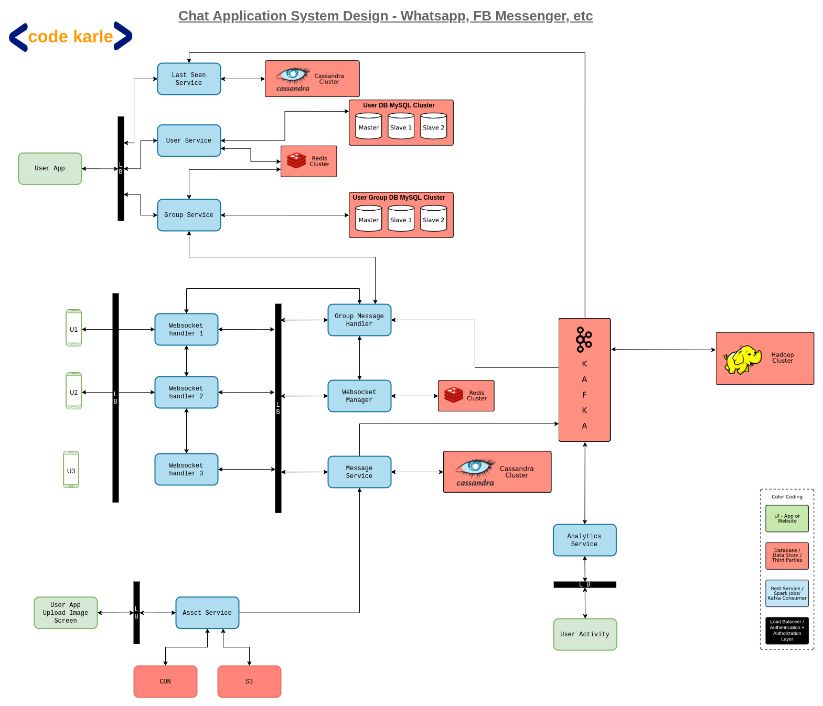
WhatsApp microservice architecture

